Slide 1

Sales Report
Period: May 2022 – July 2022
Present by:
Data Analyst Team
https://bit.ly/salesreport-agrifood

Slide 2
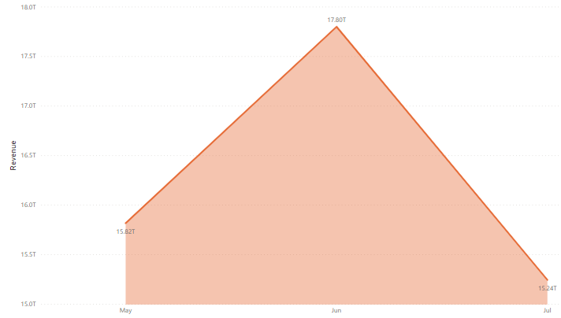

Revenue by Month
There was a decrease in revenue in July of 14.36%
(June: 17,80T and July: 15,24T)
https://bit.ly/salesreport-novi

Slide 3
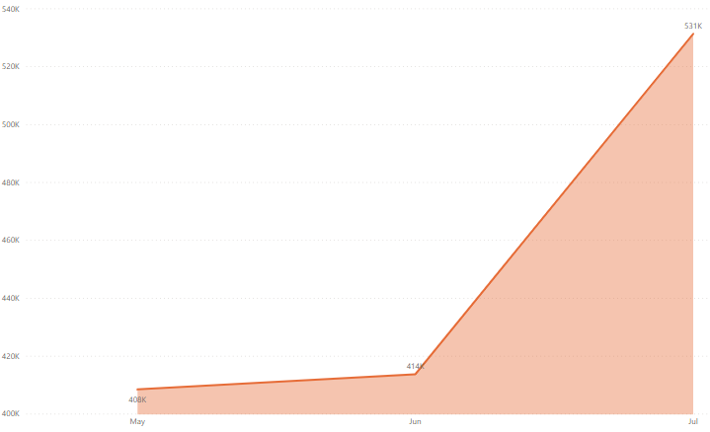

Sales Quantity by Month
However, the sales quantity in July increased by 28.42%
(June: 414k and July: 531k)
https://bit.ly/salesreport-novi

Slide 4
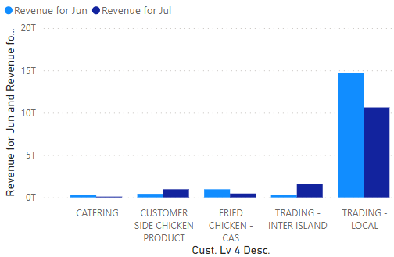
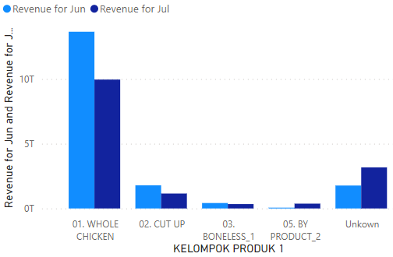
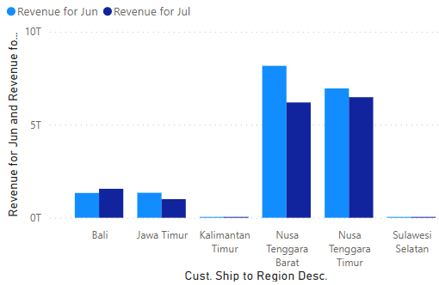
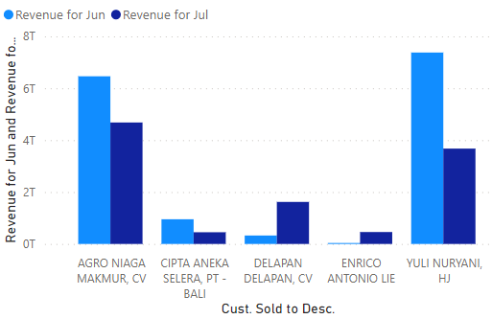
Some graphs showing the decrease in revenue from June to July
https://bit.ly/salesreport-novi

Slide 5
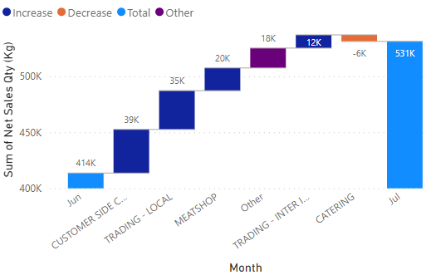
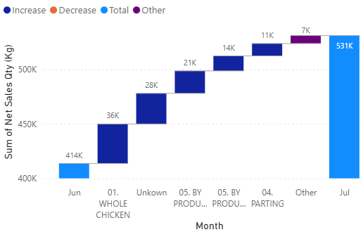
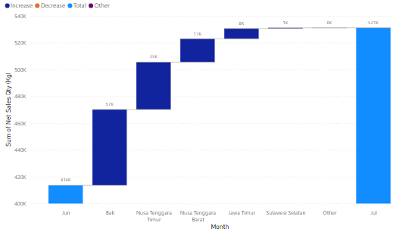
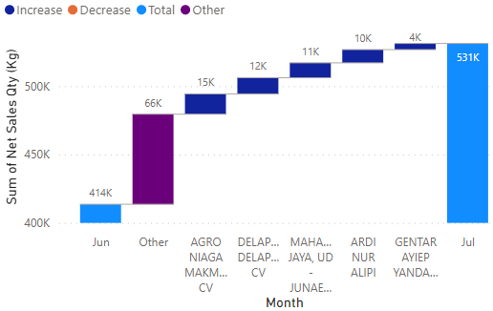
Some graphs showing the increase in sales quantity from June to July
https://bit.ly/salesreport-novi

Slide 6

Analysis
June (before Eid al-Adha) the price of chicken has increased with a demand for approximately the same amount
June
July 10, 2022 is Eid al-Adha, the opposite in June, in July there is more consumption of sacrificial animal meat, but chicken is also used as an Eid al-Adha dish, resulting in an increase in chicken supply,
The increase in chicken supply causes competition between chicken sellers to get tighter. To win the competition, chicken sellers reduce their selling prices. This decrease in the selling price of chicken causes the revenue of chicken sellers to decrease.
July
https://bit.ly/salesreport-novi

Slide 7
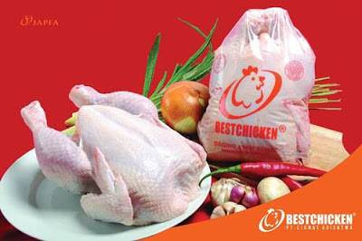
Recommendation
Adjusting the selling price of chicken. Chicken sellers need to adjust the selling price of their chicken to remain profitable, even though competition among chicken sellers is getting tougher.
Improve the quality of chicken. Chicken sellers need to improve the quality of the chicken they sell in order to compete with other sellers.
https://bit.ly/salesreport-novi

